Slide 1
Representing Knowledge Using Rules

Slide 2
Procedural and Declarative Knowledge
Procedural Knowledge is also known as Interpretive knowledge, is the type of knowledge in which it clarifies how a particular thing can be accomplished.
It is not so popular because it is generally not used.
It emphasize how to do something to solve a given problem.
Procedural knowledge derives the information on the basis of rules, strategies, agendas and procedure.
It describes how a problem can be solved.
Procedural knowledge directs the steps on how to perform something. For example: Computer program.

Slide 3
Declarative Knowledge also known as Descriptive knowledge, is the type of knowledge which tells the basic knowledge about something and it is more popular than Procedural Knowledge. It emphasize what to do something to solve a given problem.
The knowledge which is based on concepts, facts and objects, is termed as 'Declarative Knowledge'.
It provides all the necessary information about the problem in terms of simple statements, either true or false.
Declarative knowledge is explicit, which means you know that you know it. You are consciously aware of your understanding of declarative information.

Slide 4
Difference between Procedural and Declarative Knowledge
S. No. | Procedural Knowledge | Declarative Knowledge
1 | It is also known as Interpretive knowledge. | It is also known as Descriptive knowledge.
2 | Procedural Knowledge means how a particular thing can be accomplished. | While Declarative Knowledge means basic knowledge about something.
3. | Procedural Knowledge is generally not used means it is not more popular. | Declarative Knowledge is more popular.
4. | Procedural Knowledge can’t be easily communicate. | Declarative Knowledge can be easily communicate.
5. | Procedural Knowledge is generally process oriented in nature. | Declarative Knowledge is data oriented in nature.
6. | In Procedural Knowledge debugging and validation is not easy. | In Declarative Knowledge debugging and validation is easy.

Slide 5
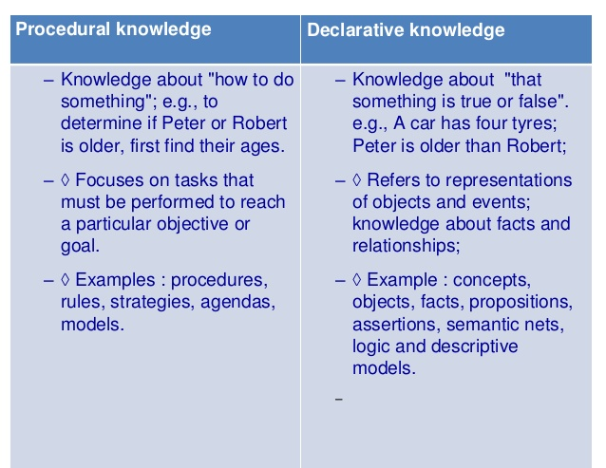

Slide 6
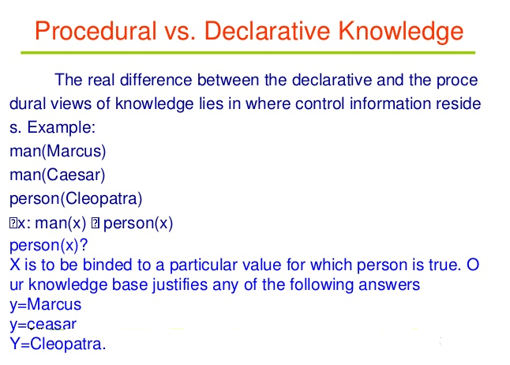

Slide 7
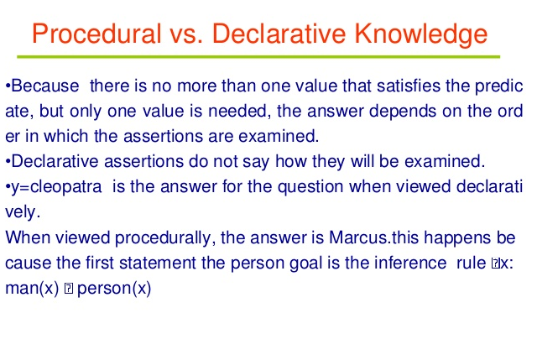

Slide 8
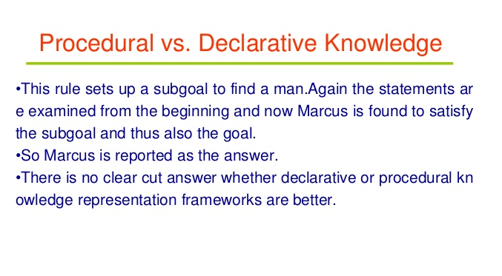

Slide 9
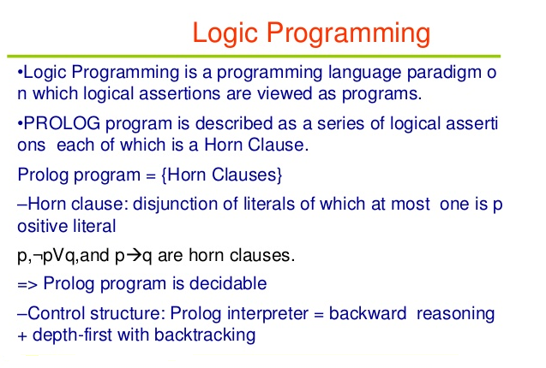

Slide 10
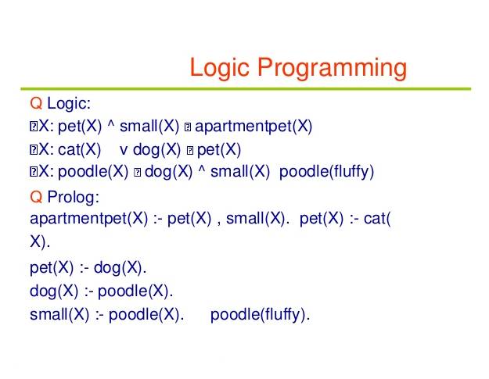

Slide 11
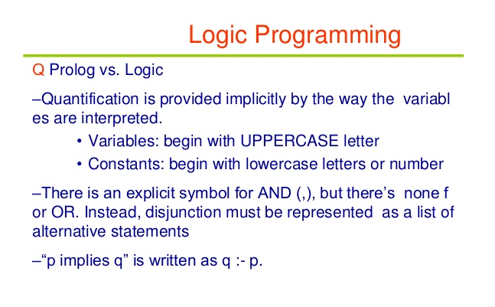

Slide 12
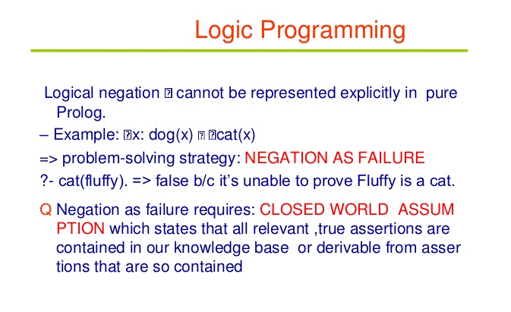

Slide 13
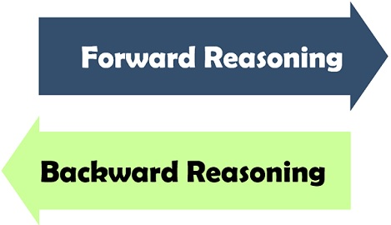
Forward versus Backward Reasoning
In Artificial intelligence, the purpose of the search is to find the path through a problem space.
There are two ways to pursue such a search that are forward and backward reasoning.
The significant difference between both of them is that forward reasoning starts with the initial data towards the goal. Conversely, backward reasoning works in opposite fashion where the purpose is to determine the initial facts and information with the help of the given results.

Slide 14
Definition of Forward Reasoning
The solution of a problem generally includes the initial data and facts in order to arrive at the solution. These unknown facts and information is used to deduce the result.
For example, while diagnosing a patient the doctor first check the symptoms and medical condition of the body such as temperature, blood pressure, pulse, eye colour, blood, etcetera.
After that, the patient symptoms are analysed and compared against the predetermined symptoms. Then the doctor is able to provide the medicines according to the symptoms of the patient. So, when a solution employs this manner of reasoning, it is known as forward reasoning.

Slide 15
Steps that are followed in the forward reasoning
The inference engine explores the knowledge base with the provided information for constraints whose precedence matches the given current state.
In the first step, the system is given one or more than one constraints.
Then the rules are searched in the knowledge base for each constraint. The rules that fulfil the condition are selected(i.e., IF part).
Now each rule is able to produce new conditions from the conclusion of the invoked one. As a result, THEN part is again included in the existing one.
The added conditions are processed again by repeating step 2. The process will end if there is no new conditions exist.

Slide 16
Definition of Backward Reasoning
The backward reasoning is inverse of forward reasoning in which goal is analysed in order to deduce the rules, initial facts and data.
We can understand the concept by the similar example given in the above definition, where the doctor is trying to diagnose the patient with the help of the inceptive data such as symptoms.
However, in this case, the patient is experiencing a problem in his body, on the basis of which the doctor is going to prove the symptoms. This kind of reasoning comes under backward reasoning.

Slide 17
Steps that are followed in the backward reasoning
In this type of reasoning, the system chooses a goal state and reasons in the backward direction. Now, let’s understand how does it happens and what steps are followed.
Firstly, the goal state and the rules are selected where the goal state reside in the THEN part as the conclusion.
From the IF part of the selected rule the subgoals are made to be satisfied for the goal state to be true.
Set initial conditions important to satisfy all the subgoals.
Verify whether the provided initial state matches with the established states. If it fulfils the condition then the goal is the solution otherwise other goal state is selected.

Slide 18
Key Differences Between Forward and Backward Reasoning in AI
Reasoning in AI
The forward reasoning is data-driven approach while backward reasoning is a goal driven.
The process starts with new data and facts in the forward reasoning. Conversely, backward reasoning begins with the results.
Forward reasoning aims to determine the result followed by some sequences. On the other hand, backward reasoning emphasis on the acts that support the conclusion.
The forward reasoning is an opportunistic approach because it could produce different results. As against, in backward reasoning, a specific goal can only have certain predetermined initial data which makes it restricted.
The flow of the forward reasoning is from the antecedent to consequent while backward reasoning works in reverse order in which it starts from conclusion to incipient.

Slide 19
Conclusion
The production system structure of the search process facilitates in the interpretation of the forward and backward reasoning.
The forward and backward reasoning are differentiated on the basis of their purpose and process, in which forward reasoning is directed by the initial data and intended to find the goal while the backward reasoning is governed by goal instead of the data and aims to discover the basic data and facts.

Slide 20
Forward Chaining
Forward chaining is also known as a forward deduction or forward reasoning method when using an inference engine. Forward chaining is a form of reasoning which start with atomic sentences in the knowledge base and applies inference rules (Modus Ponens) in the forward direction to extract more data until a goal is reached.
The Forward-chaining algorithm starts from known facts, triggers all rules whose premises are satisfied, and add their conclusion to the known facts. This process repeats until the problem is solved.
Properties of Forward-Chaining:
It is a down-up approach, as it moves from bottom to top.
It is a process of making a conclusion based on known facts or data, by starting from the initial state and reaches the goal state.
Forward-chaining approach is also called as data-driven as we reach to the goal using available data.
Forward -chaining approach is commonly used in the expert system, such as CLIPS, business, and production rule systems.

Slide 21
Backward Chaining:
Backward-chaining is also known as a backward deduction or backward reasoning method when using an inference engine.
A backward chaining algorithm is a form of reasoning, which starts with the goal and works backward, chaining through rules to find known facts that support the goal.
Properties of backward chaining:
It is known as a top-down approach.
Backward-chaining is based on modus ponens inference rule.
In backward chaining, the goal is broken into sub-goal or sub-goals to prove the facts true.
It is called a goal-driven approach, as a list of goals decides which rules are selected and used.
Backward -chaining algorithm is used in game theory, automated theorem proving tools, inference engines, proof assistants, and various AI applications.
The backward-chaining method mostly used a depth-first search strategy for proof.

Slide 22
Forward Chaining Vs. Backward Chaining
1. Forward chaining starts from known facts and applies inference rule to extract more data unit it reaches to the goal.
Backward chaining starts from the goal and works backward through inference rules to find the required facts that support the goal.
2. It is a bottom-up approach
It is a top-down approach
3. Forward chaining is known as data-driven inference technique as we reach to the goal using the available data.
Backward chaining is known as goal-driven technique as we start from the goal and divide into sub-goal to extract the facts.
4. Forward chaining reasoning applies a breadth-first search strategy.
Backward chaining reasoning applies a depth-first search strategy.
5. Forward chaining tests for all the available rules
Backward chaining only tests for few required rules.
6.Forward chaining is suitable for the planning, monitoring, control, and interpretation application.
Backward chaining is suitable for diagnostic, prescription, and debugging application.
7.Forward chaining can generate an infinite number of possible conclusions.
Backward chaining generates a finite number of possible conclusions.
8.It operates in the forward direction.
It operates in the backward direction.
9. Forward chaining is aimed for any conclusion.
Backward chaining is only aimed for the required data.

